Slide 1

Dev & Build Process Design 9th September 2020
Allen Coates
Rob Kent
Rachel Liu

Slide 2
Agenda
Revised & updated ‘as is’ workflows (10min)
An initial build on XLR using manual tasks modelling (10min)
An initial view on the ‘to be’ target state design (20min)
Implementation Plan (20min)
Additional requirement
Q & A on the orchestration tool

Slide 3
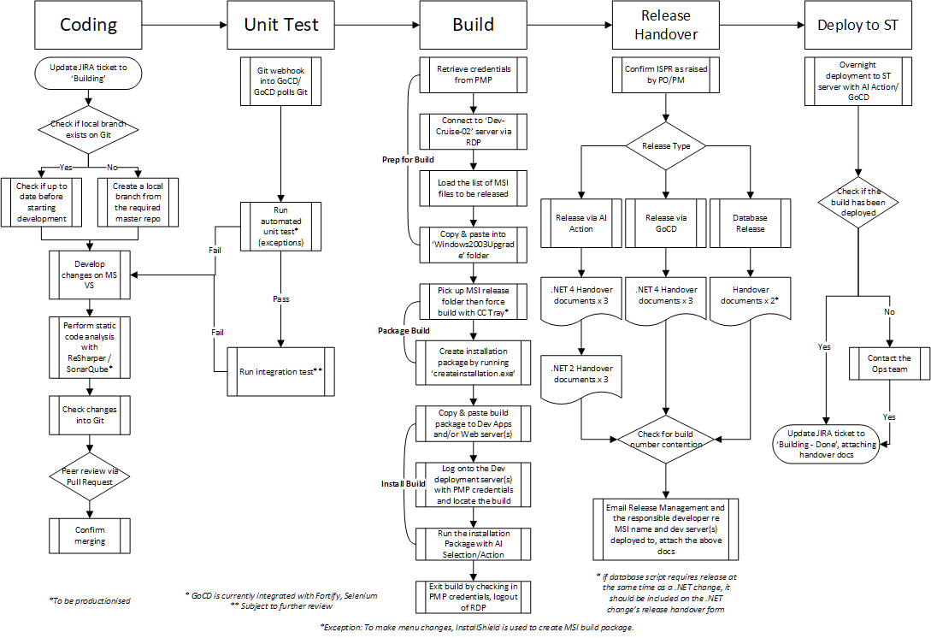
Current Process within Dev’s .NET MSI Daily Build Release

Slide 4
Target State Design for Dev’s .NET MSI Daily Build Release (Draft)

Slide 5
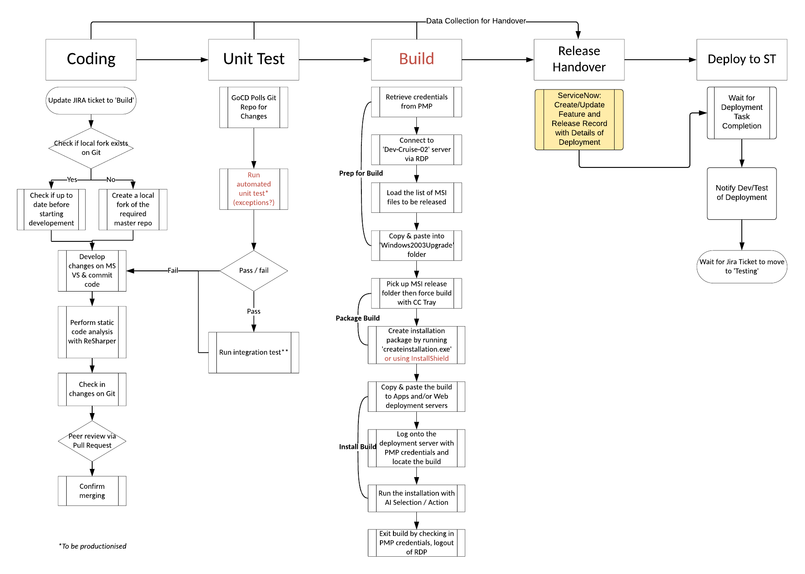
Bridge the Gap: Jira – ServiceNow

Slide 6
Continuous Improvement
Baseline in Production to identify bottlenecks and opportunities for improvements
Focus predominately of shift left/faster feedback and velocity improvements
Expand number of integrations to increase opportunities for automation
Longer term automation of end to end release activities from Development to Production

Slide 7
Implementation – Next Steps
XLR Test and Prod Infrastructure Deployments*
Jira Versioning/Release Issue to track Metadata
Github Integration*
ServiceNow Integration*
GoCD Plugin*
GoCD Integration*
Release/Feature Mapping from Jira et al to ServiceNow
*In Progress

Slide 8
Q & A on XLR the Orchestration Tool
Helps Developers to stay in the Jira world and allows Service/Change/Release Management to stay in the ServiceNow world
Bridges the gap between Jira and ServiceNow – allows automatic creation/updating of ServiceNow data and/or related Jira issues
Provides the ability to track components/applications through the development & release life cycle
Initially, we treat areas as black boxes to just obtain metrics
Overtime, we make the black boxes more transparent to gain more visibility
More metrics allows focused improvements

Slide 9
Thank you.

